Slide 1
My Gebi · ገቢ
Your online store and My Gebi Market
Sell beyond your street, with the same app.

Slide 2
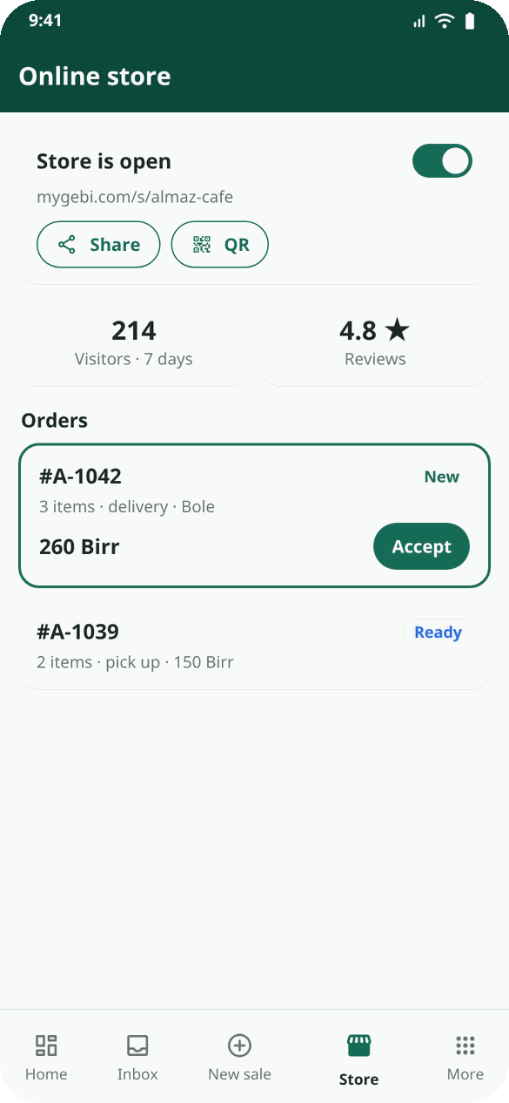
Turn your store on
• Store tab → turn the store on. Your link: mygebi.com/s/your-shop and a QR code.
• Add delivery and its fee, and the shop Telebirr number buyers pay to.
• Business profile: logo, a photo of the shop front, opening hours, Telegram or Instagram.
• Shop location: stand inside the shop and tap "Use my current location".
My Gebi · mygebi.com · 2/7

Slide 3
Items that sell
• Store → Items → Add item: name, price, category, up to 6 photos, description.
• Choices for clothes or flavours: Size, Colour…
• How you sell it: fixed price, offers (buyers offer less; you answer), or auction.
• Short names, clear photos, details filled in (amount, pack, size, brand).
• Stopped selling something? Open it → 🗑 Delete. Old sales and reports keep it.
My Gebi · mygebi.com · 3/7

Slide 4
Orders, step by step
• The till beeps for each order or offer.
• Accept → It is ready → Handed over: it is saved as a normal sale.
• Delivery? Hand it to your courier or to a My Gebi delivery partner; the buyer gives the courier a 4-digit code.
Example: Selam Boutique put 20 dresses online on Friday. On Sunday a buyer from CMC offered 5,800 for a 6,500 kemis. Selam replied 6,200, the buyer accepted, and a courier delivered it the same afternoon.
My Gebi · mygebi.com · 4/7

Slide 5
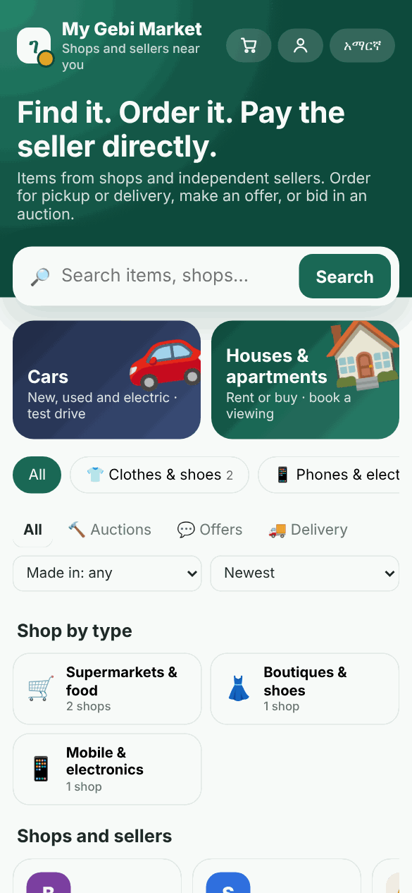
My Gebi Market
• mygebi.com/market shows items from every open store, by department.
• To be listed: a photo, a department, the kind of item and how many you have.
• Add the brand and the country it was made in: buyers search for it.
• The blue Verified tick: call My Gebi to have your ID or trade licence checked.
My Gebi · mygebi.com · 5/7

Slide 6
What it costs
• Your first 10 online orders are free, then 5% of each finished order (items only).
• You see and pay it on the Store tab.
• If too much is unpaid, new online orders pause until you pay.
My Gebi · mygebi.com · 6/7

Slide 7
Grow your store
• Share your link and QR on Telegram, TikTok and Instagram; print the QR at the counter.
• Answer offers fast; reply politely to reviews.
• Store → Visitors: many visitors but few orders? Check price, photos and details.
• Rules: real photos and prices, only items you may legally sell.
My Gebi · mygebi.com · 7/7

