Slide 1
My Gebi · ገቢ
Start in 10 minutes
Your business on My Gebi, today.

Slide 2
What you need
• Your phone with My Gebi (mygebi.com/get or the Gebi Telegram bot).
• The phone that receives your Telebirr and CBE SMS.
• Your trade licence (for the TIN), your price list and your staff names.
My Gebi · mygebi.com · 2/8

Slide 3
1. Register
• Open My Gebi → Register my business.
• Choose your type: café, barbershop, shop, boutique, pharmacy…
• Your name, phone, business name, area and TIN (the 10-digit number on your trade licence). The first 30 days are free.
My Gebi · mygebi.com · 3/8

Slide 4
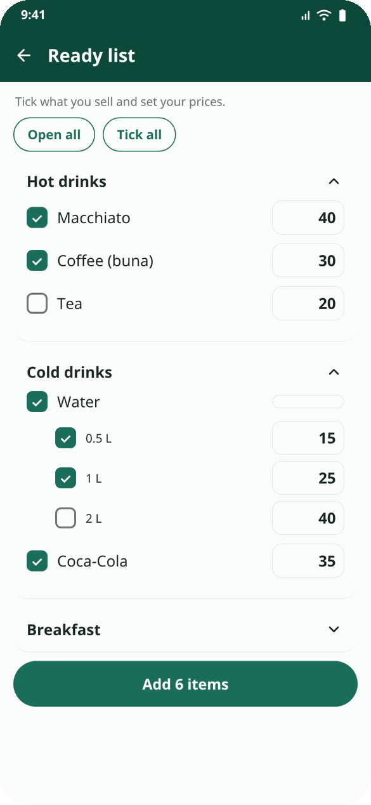
2. Add your items
• Ready list: tick and set prices: a full list for your type. No time for prices? Leave them empty: each item gets the suggested price and a Check price reminder until you set yours.
• Tick what you sell, type your price, Add all at once.
• Drinks in sizes? Each size gets its own price.
My Gebi · mygebi.com · 4/8

Slide 5
3. Add your team
• More → Staff & items → add each person and their role.
• Each cashier gets a 4-digit PIN: write it down for them.
• Save their phone so they can use My Gebi Staff on their own phone.
My Gebi · mygebi.com · 5/8

Slide 6
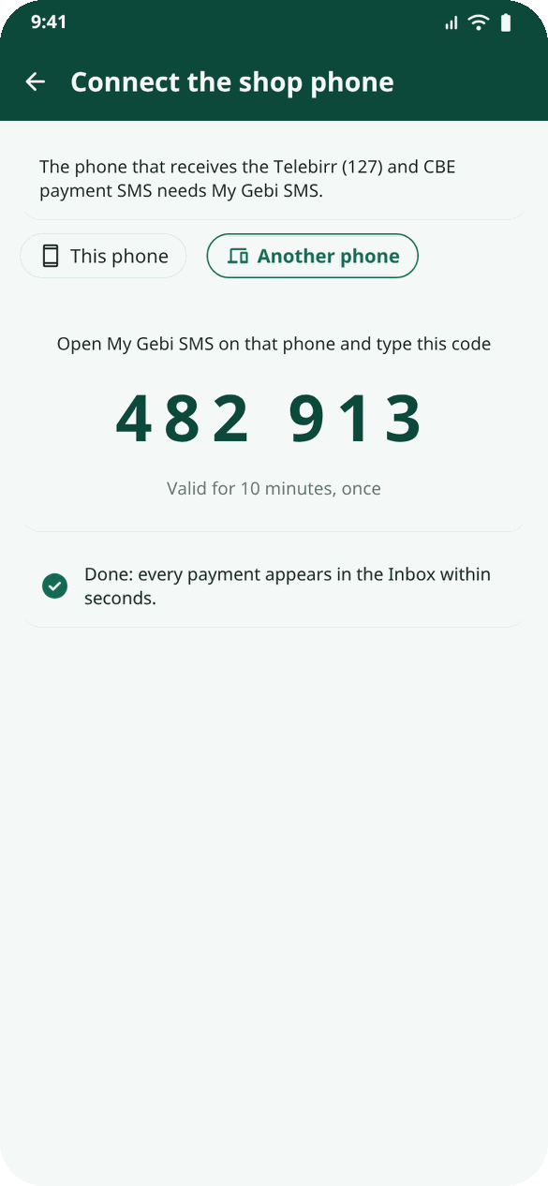
4. Connect the shop phone
• Install My Gebi SMS on the phone that gets Telebirr (127) and CBE SMS.
• More → Connect the shop phone. Same phone: This phone. Another phone: type the 6-digit code there.
• Allow SMS. Now every payment reaches your Inbox in seconds.
My Gebi · mygebi.com · 6/8

Slide 7
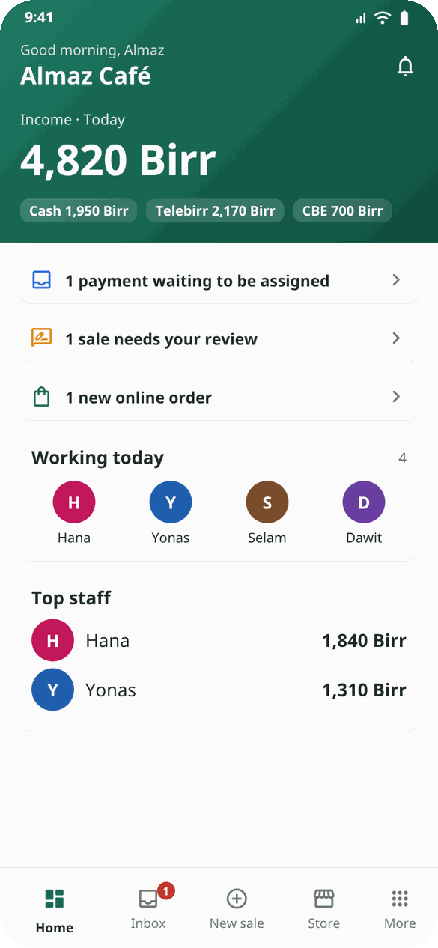
5. Your first sale
• Ask someone to pay you 1 Birr by Telebirr.
• It appears in the Inbox. Tap it → who served → what they bought → Confirm.
• Open Home: today's money, by cash, Telebirr and CBE.
My Gebi · mygebi.com · 7/8

Slide 8
Tips for a good start
• Connect Telegram reports (More → Telegram reports): the day's report every evening.
• Put the Telebirr and CBE accounts in exactly as on the receipts.
• Show your cashiers the Inbox on day one.
• Stuck? More → Gebi support: a real person helps, in Amharic.
Example: Almaz registered her café at 9 in the morning. By 10 her 4 staff had PINs, 40 items were in, and the first Telebirr payment of the day was already a sale with Hana's name on it.
My Gebi · mygebi.com · 8/8

