Slide 1
My Gebi · ገቢ
Getting help from Gebi
Real people, in Amharic, and you stay in control.

Slide 2
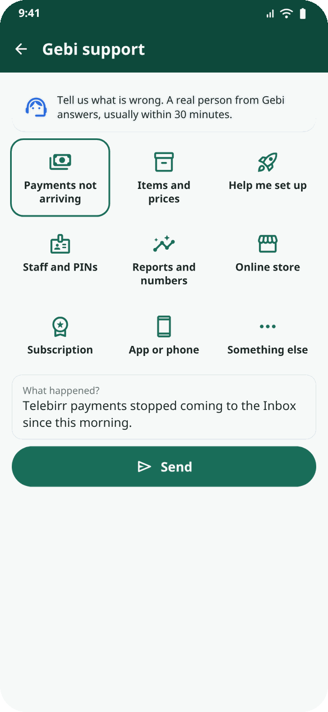
Ask for help
• More → Gebi support.
• Pick what it is about (payments, items, setup, staff, reports, store…) and write what happened.
• You get a case number like GS-1042. Replies come in the app and on Telegram.
My Gebi · mygebi.com · 2/6

Slide 3
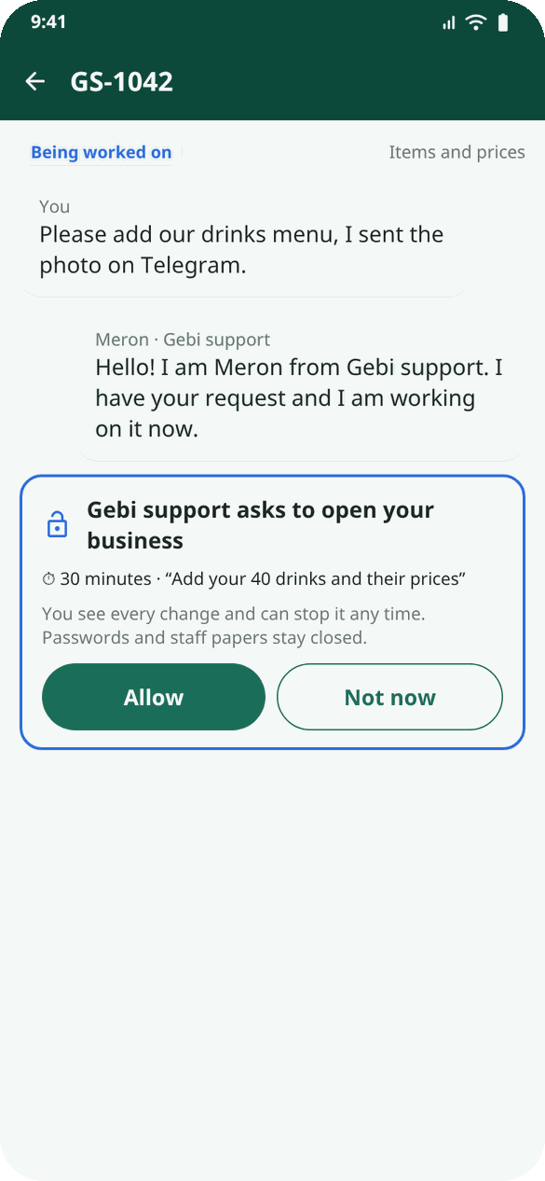
If support needs to work inside
• They ask on your case: how long (15 minutes to 2 hours) and exactly what they will do.
• You choose Allow or Not now. Nothing happens without your Allow.
My Gebi · mygebi.com · 3/6

Slide 4
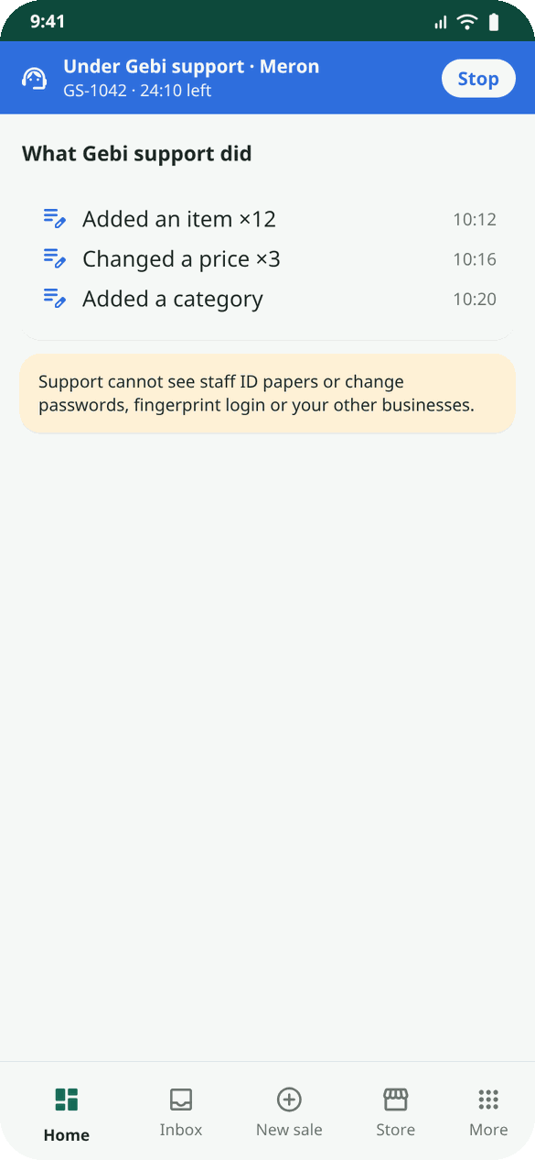
While they work
• A blue bar: Under Gebi support, the name, the time left, and Stop.
• Every change is listed on your case: "Added an item ×12".
• Closed to support: your password, fingerprint login, staff ID papers, your other businesses, deleting.
My Gebi · mygebi.com · 4/6

Slide 5
When it is solved
• You get a closing message: what was wrong, what they did, what to do next.
• Rate the help with stars.
• Not solved? Tap Still not solved within 7 days.
My Gebi · mygebi.com · 5/6

Slide 6
Other help
• Forgot your password? Login → Forgot password? → a code from the Gebi Telegram bot. No Telegram? Call Gebi support.
• Cashier forgot the PIN? Staff → the person → New PIN.
• New phone number? Settings → Change my phone number: the new number, your password and the fee (1,000 birr by Telebirr). Gebi support calls you on your old number to check it is you, then changes it. Your data stays.
• Deleted your business and came back? Register with the same phone: the app offers Bring them back (items, staff, accounts).
• New version? The green bar at the top, or "Download Gebi" in the Telegram bot. Updating never loses data.
Example: Yonas's restaurant had 60 dishes to add. He asked Gebi support, allowed 1 hour, and watched the dishes appear while he served lunch. At 2 o'clock the case closed: "Done: 60 dishes in 6 categories."
My Gebi · mygebi.com · 6/6

