Slide 1
My Gebi · ገቢ
Your day with My Gebi
Five minutes a day, every birr counted.

Slide 2
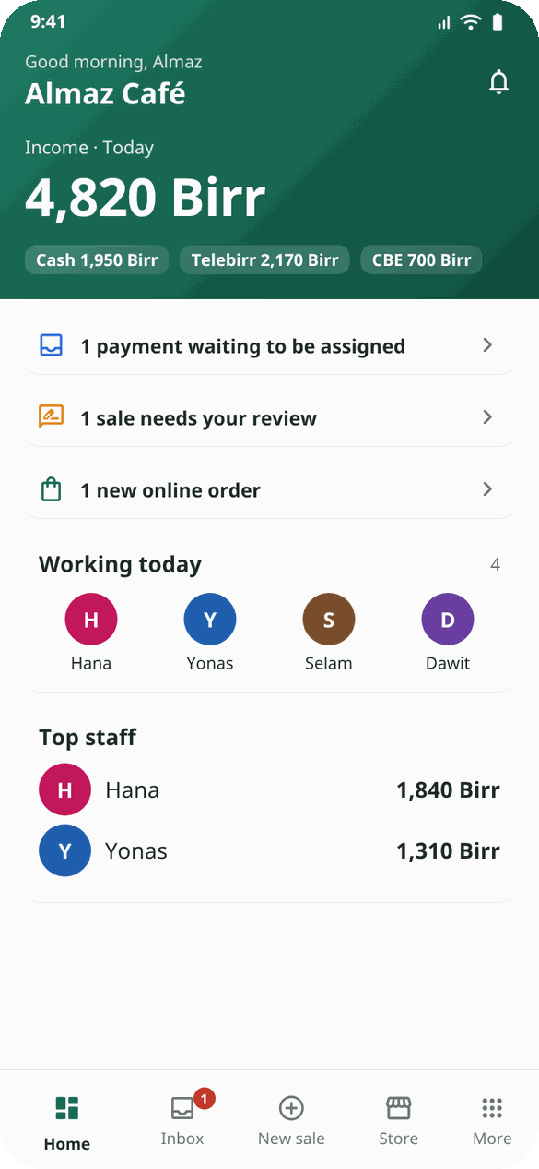
Morning: open the shop
• Is the SMS phone charged, online and with My Gebi SMS open?
• Look at Home: who is working today, bookings, anything waiting.
• Yellow or red notes at the top? Tap them first.
My Gebi · mygebi.com · 2/8

Slide 3
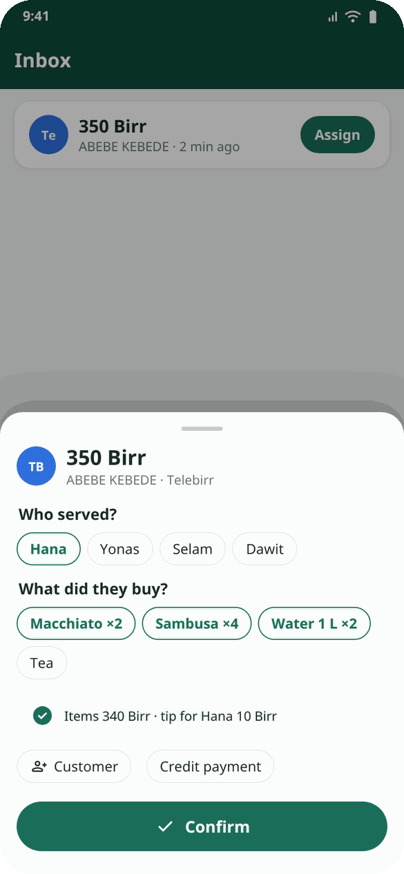
All day: payments
• Telebirr / CBE: the till beeps → Inbox → tap → who served → what they bought → Confirm.
• Cash: New sale → worker → items → Cash → Save sale.
• Receipt did not arrive? New sale → Scan QR (camera or screenshot).
• A tip later, with no sale? New sale → Tip only.
My Gebi · mygebi.com · 3/8

Slide 4
Pay by QR: the till as a calculator
• New sale → choose the items: the total shows at once. Tell the customer the price.
• Long press on the total (or the QR button): the amount big, your Telebirr QR; swipe for CBE, with the number and your name.
• The customer scans and pays. When the SMS reaches the Inbox, the sale saves itself.
• First time: add your QR codes once (a screenshot of "My QR" in the Telebirr and CBE apps).
• The bell at the top: new orders, bookings, support replies and news from My Gebi.
My Gebi · mygebi.com · 4/8

Slide 5
Rush hour tips
• Assign payments as they come: it takes 5 seconds; at night it takes an hour.
• Double tap a worker's name in New sale: their sales today and their tips.
• No internet? Keep selling. The orange bar shows sales waiting; they go by themselves.
My Gebi · mygebi.com · 5/8

Slide 6
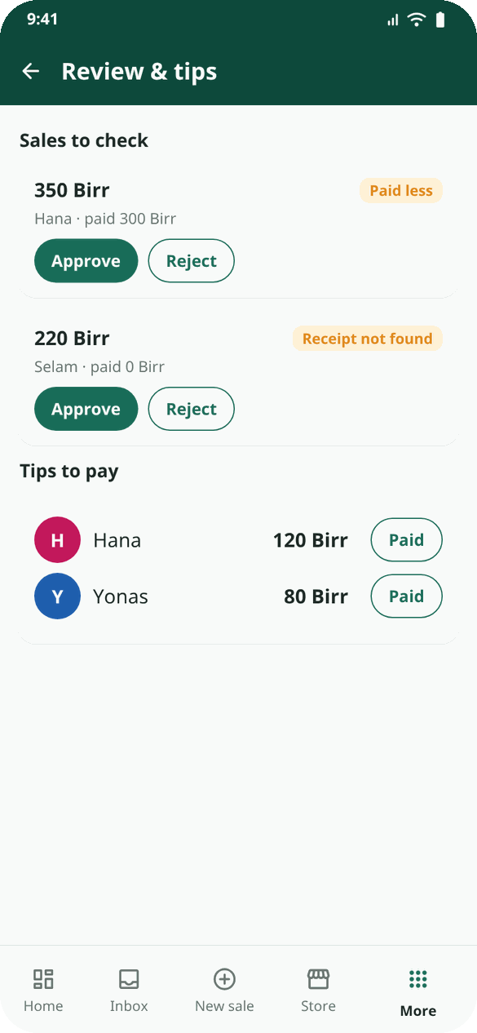
Afternoon: check
• More → Review & tips: approve or reject sales that were paid less or had no receipt.
• Cash taken from the drawer (to buy milk, to pay a supplier)? Record Cash taken from the till or an expense.
My Gebi · mygebi.com · 6/8

Slide 7
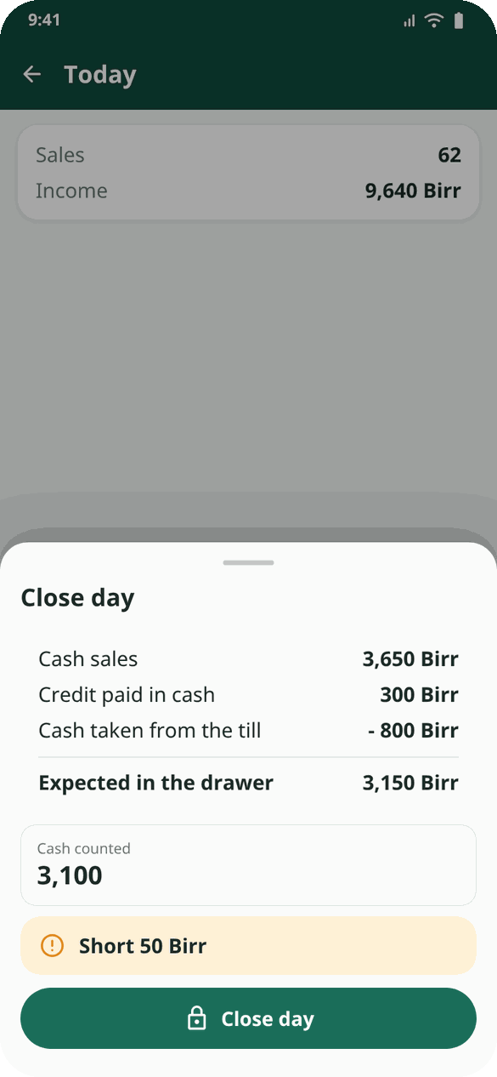
Evening: close the day
• Today → Close day.
• Count the drawer, type the amount.
• See expected, counted and the difference.
• Your Telegram report arrives: today, yesterday, this week.
My Gebi · mygebi.com · 7/8

Slide 8
Once a week
• Reports: best sellers, busy hours, each person's work.
• Tips to pay: hand over, tap Paid.
• Expenses: rent, salaries, stock. Repeat monthly ones automatically.
• Customers who haven't come back: call or SMS them.
Example: Dawit's barbershop closes the day at 8 in the evening. The cash count was 50 Birr short. Then he remembered: he took 50 Birr for bread at noon. He recorded it as Cash taken from the till and the difference became 0.
My Gebi · mygebi.com · 8/8

